Slide 1
Pharmacology of the Renal system
Diuretics
Dr Ken Wojcikowski

Slide 2
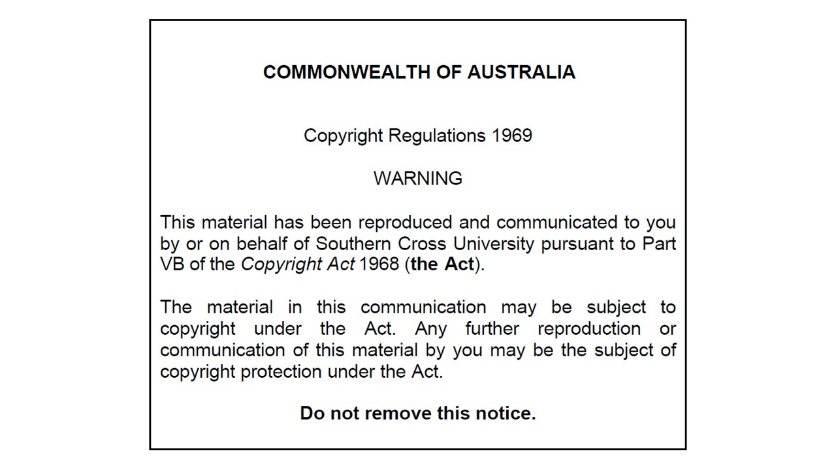

Slide 3
Objectives for the renal system
Describe the structure and function of the portions of the renal system relevant to diuretics.
Identify and explain the actions interactions and side effects of diuretics.

Slide 4
kjhkjhlkdfs
Medications of the Cardiovascular/Renal System:
Diuretics
Lesson 1:
Understanding the foundational information about diuretics

Slide 5
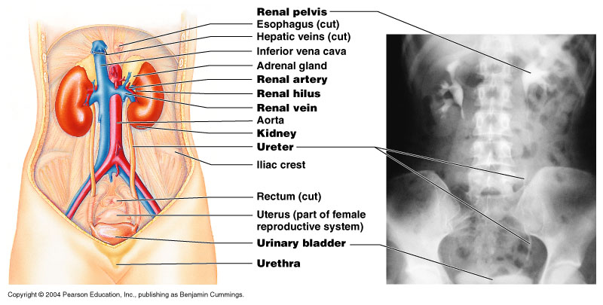
Location of the kidneys, ureters and bladder

Slide 6
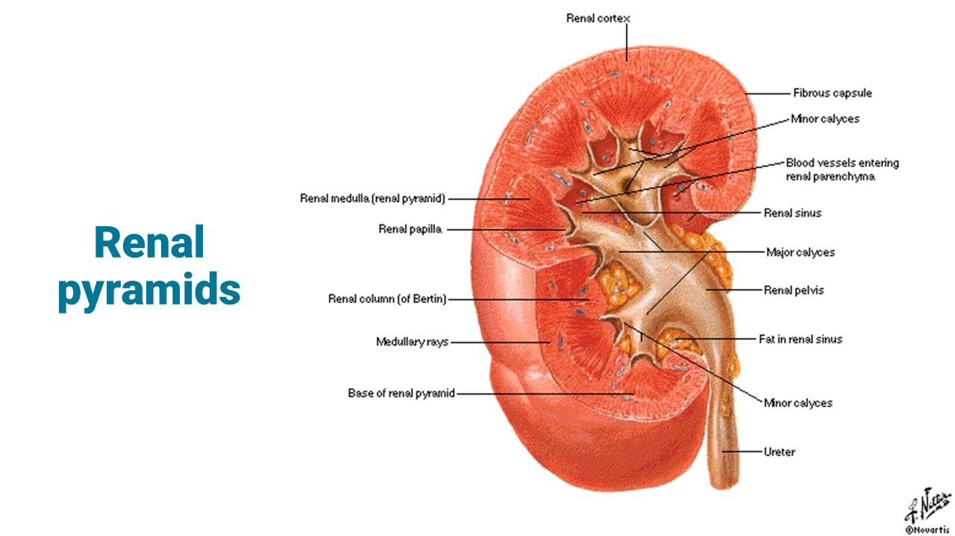

Slide 7
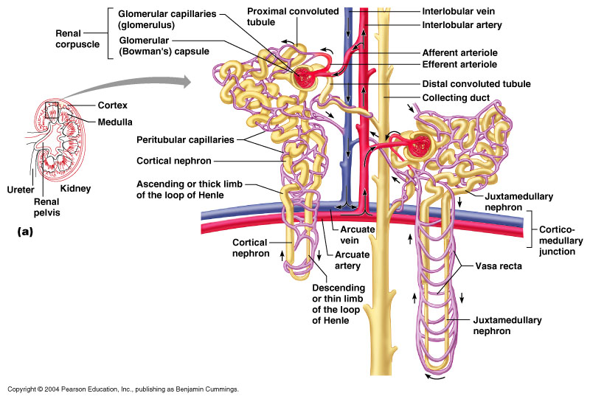

Slide 8
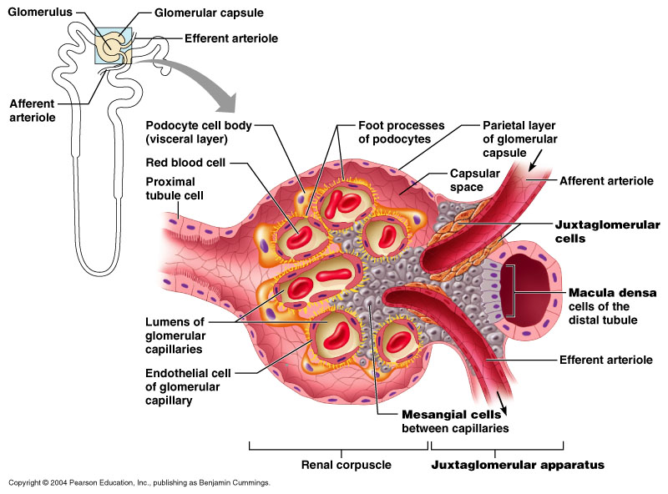

Slide 10
kjhkjhlkdfs
Medications of the Cardiovascular/Renal System:
Diuretics
Lesson 2:
Understanding the foundational information about diuretics (continued)

Slide 11
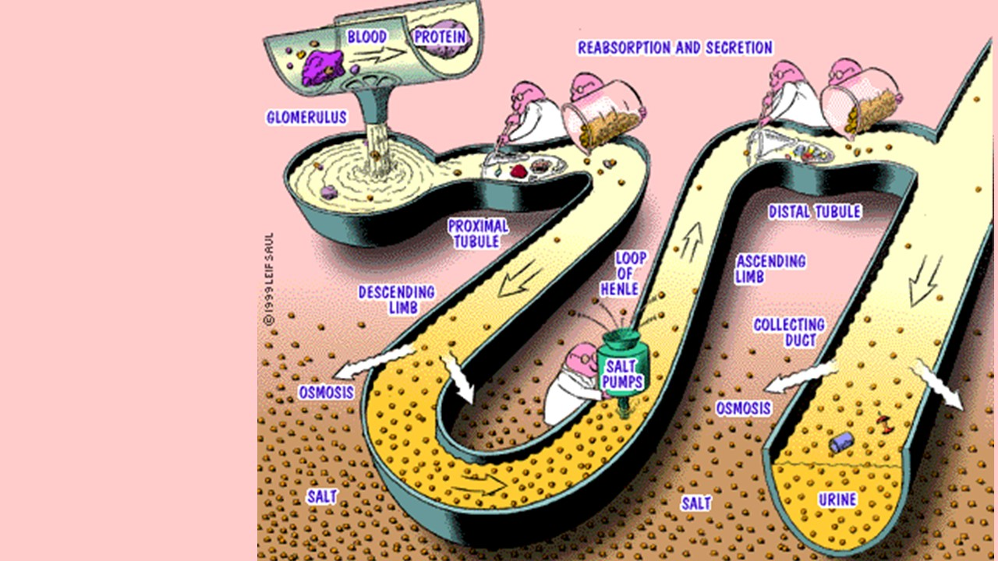

Slide 12
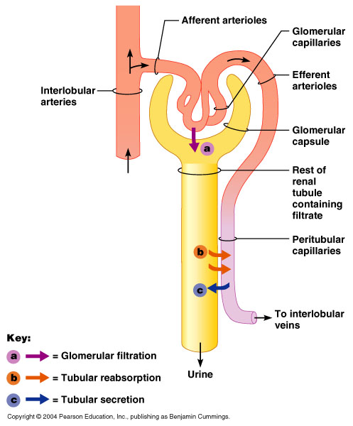
Filtration, reabsorption and secretion

Slide 13
Reabsorption and Secretion
Reabsorption and secretion are confusing because we are talking about the tubule but the terms apply to the what is happening in relation to the peritubular blood supply.
  Reabsorption of water and solutes by tubular cells into the peritubular capillary blood
  Secretion from the blood into the tubular lumen

Slide 14
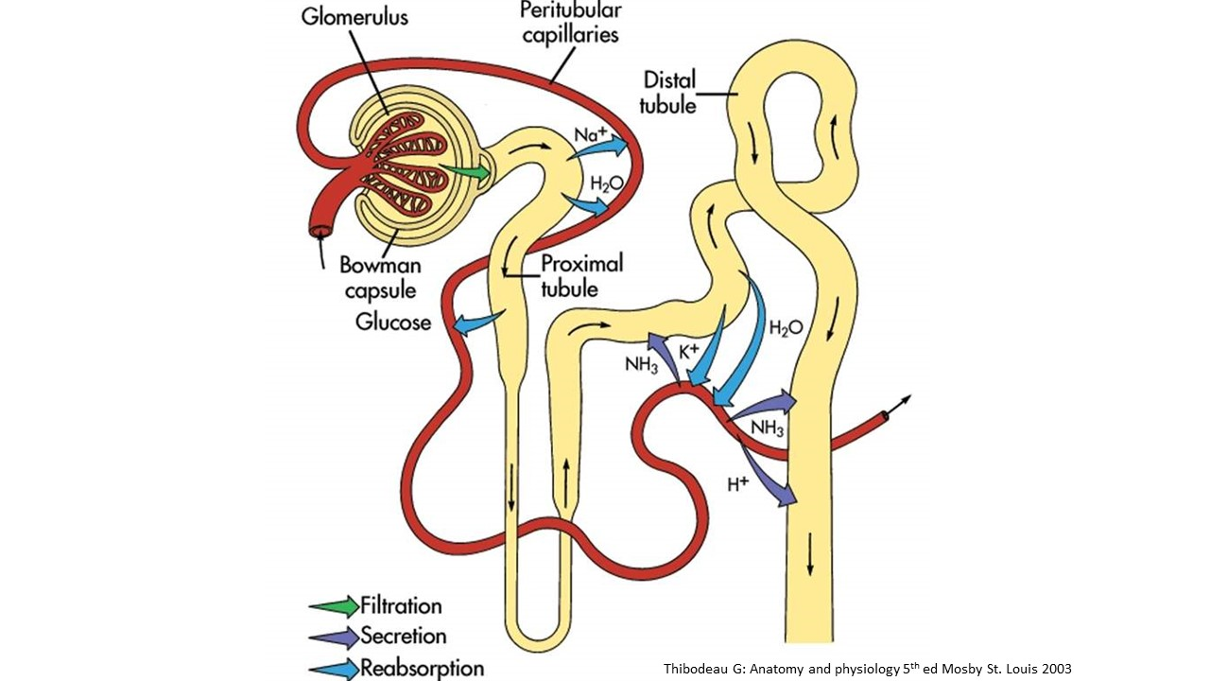

Slide 15
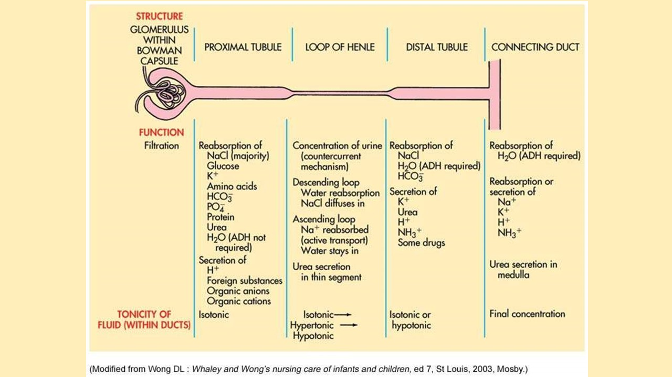
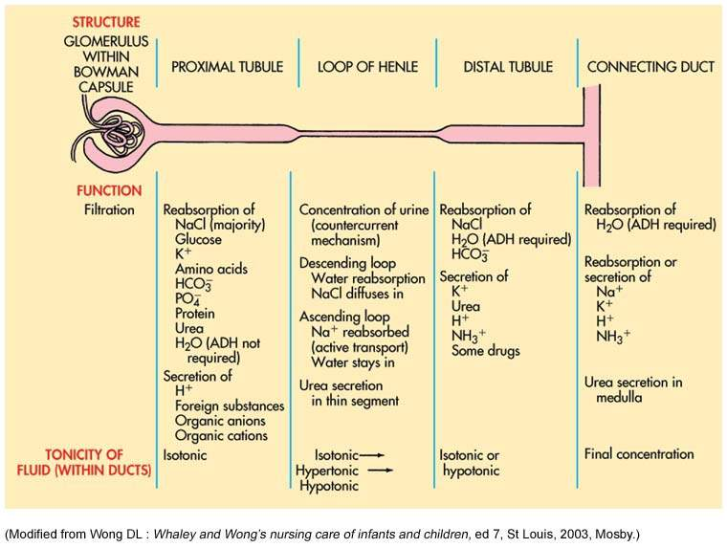

Slide 16
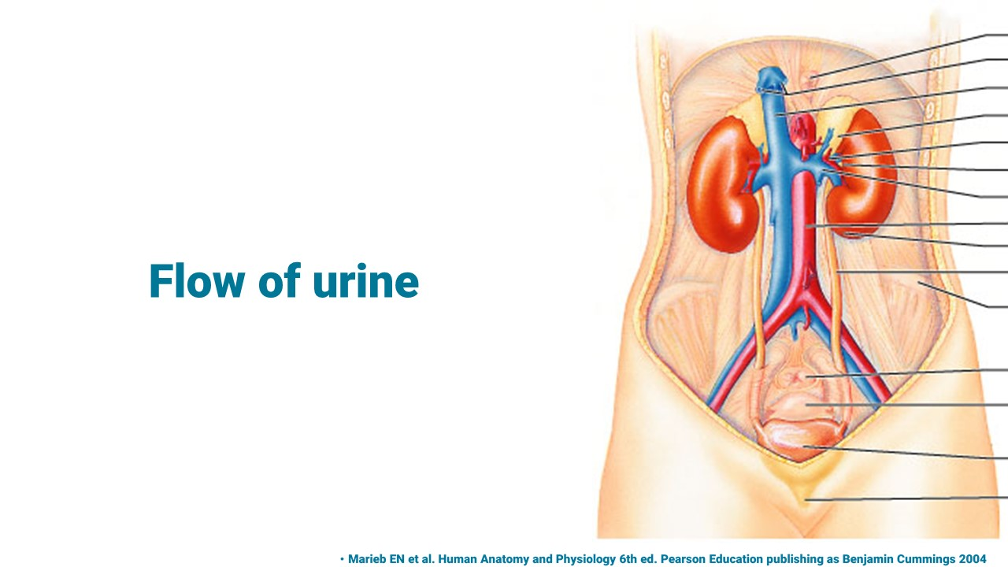
Flow of urine

Slide 17
Patients commencing diuretics
Care must be taken to avoid fluid rebound.
Some patients decrease water consumption when they commence diuretics to decrease trips to the bathroom
If water is decreased at the same time as diuretic is commenced, rebound oedema will result!

Slide 18


Slide 19
kjhkjhlkdfs
Medications of the Cardiovascular/Renal System:
Diuretics
Lesson 3:
Thiazide and thiazide-like diuretics

Slide 20
Thiazide diuretics (hydrochlorothiazide)
Thiazide like diuretic (metolazone)
Inhibit sodium reabsorption from the distal tubule
Wastes potassium as well
Used for hypertension, congestive heart failure, nephrolithiasis (kidney stones) and diabetes insipidus
Thiazide diuretics compete with the secretion of uric acid so they are contraindicated in people with gout
Several drugs use hydrochlorothiazide in combination – a little bit increases the action of other
    Hydrochlorothiazide
    ‘thiazide” drugs

Slide 21
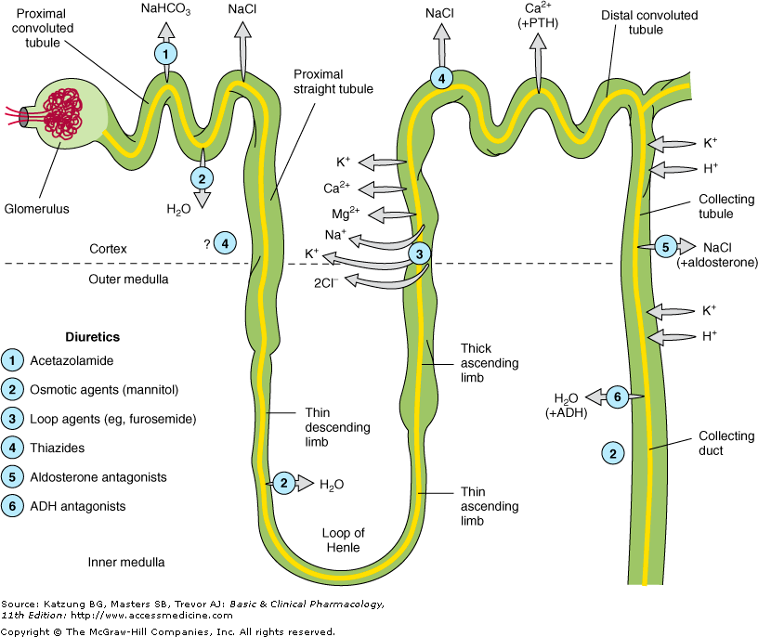
Thiazide toxicity
Allergic reaction (sulphonamides used in antimicrobial agents)
Photosensitivity (skin; light pinkish skin are most sensitive)
Hypokalaemia (low potassium)
Hyponatraemia (low salt Na+)
Hyperuricaemia (gout)
Hydrochlorothiazide
  (Dithiazide)
May increase risk of type 2 diabetes
May increase lipid levels
Contraindicated in pregnancy
Distal convoluted tubule
Katung BG, Masters SB: Basic and Clinical Pharmacology 11th ed. McGraw-Hill Companies, Inc

Slide 22
Thiazide diuretics
(hydrochlorothiazide)
May be indicated as an additional therapy for people with osteoporosis
  Increases osteoblastic cells
  Increases calcium levels.

Slide 23
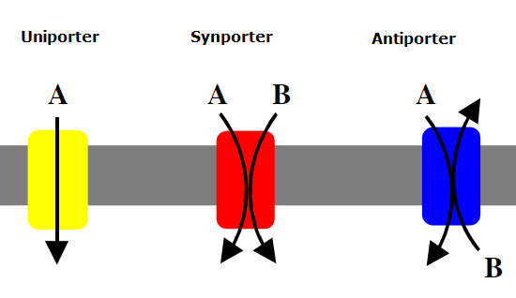
A symporter on the cell surface

Slide 24
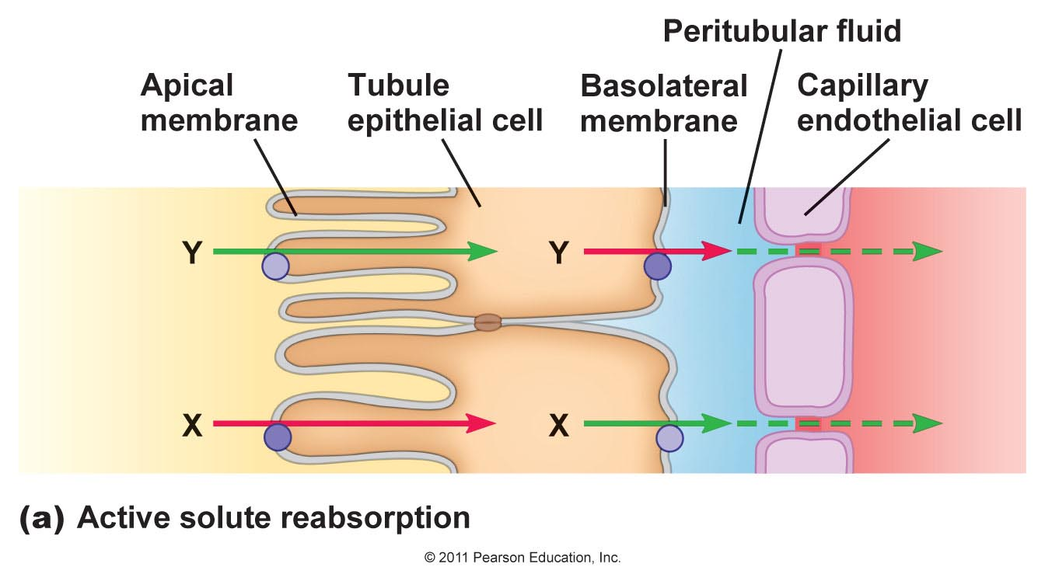

Slide 25
kjhkjhlkdfs
Medications of the Cardiovascular/Renal System:
Diuretics
Lesson 4:
Loop diuretics

Slide 26
Loop diuretics
Furosemide (Lasix) and other loop diuretics work on the ascending loop of Henle
They indirectly block active transportation of sodium, potassium and chloride into the interstitial space where they would normally re-enter circulation
Sodium rich urine
Work in the ascending loop of Henle
Katung BG, Masters SB: Basic and Clinical Pharmacology 11th ed. McGraw-Hill Companies, Inc

Slide 27
Loop diuretics
Produce a loss of fluid of up to 10 L/d
Drugs of choice when rapid diuresis is needed
Oral, IV or IM
Alkalosis is possible
Calcium is lost
Work in the ascending loop of Henle
Katung BG, Masters SB: Basic and Clinical Pharmacology 11th ed. McGraw-Hill Companies, Inc

Slide 28
Loop diuretics
Furosemide is Lasix (lasts six hours)
Lasix prevents the reabsorption of:
  Sodium
  Potassium
  Calcium
  Magnesium
Therefore, monitor for
  Hypovolaemia and hyponaturemia
  Hypokalemia
  Hypocalcaemia
  Hypomagnesemia
  Also, allergies to those allergic to sulphonamides

Slide 29
kjhkjhlkdfs
Medications of the Cardiovascular/Renal System:
Diuretics
Lesson 5:
Potassium sparing diuretics

Slide 30
Potassium sparing diuretics
Blocks aldosterone at the distal tubule
Blocks aldosterone at the distal tubule
Spironolactone (know this drug)
OR
Indirectly blocks the NaCl pumps at the same spot
Amiloride
Katung BG, Masters SB: Basic and Clinical Pharmacology 11th ed. McGraw-Hill Companies, Inc

Slide 31
Potassium-sparing diuretics
Spironolactone
Blocks aldosterone at the distal tubule
Used for any aldosterone excess states.
Toxicity includes hyperkalaemia (raised k+ potassium levels)
Blocks androgen as well (dysmenorrhoea in women, breast development in males)

Slide 32
Potassium-sparing diuretics
Potassium-sparing diuretics
  Spironolactone (Aldactone): Aldosterone antagonist
  Amiloride: Blocks sodium channels
Spironolactone was at one time thought to be important for all patients with hypertension but it causes hyperkalaemia
Some say it should not be used with ACE inhibitors, but some people can tolerate it

Slide 33
kjhkjhlkdfs
Medications of the Cardiovascular/Renal System:
Diuretics
Lesson 6:
Other diuretics

Slide 34
ADH antagonists
“…vaptan” drugs
  Blocks ADH receptors
ETOH (alcohol)
  Inhibits pituitary secretion of ADH
  Not used as a diuretic but this explains why one is dehydrated after intoxication
Blocks ADH receptors
Katung BG, Masters SB: Basic and Clinical Pharmacology 11th ed. McGraw-Hill Companies, Inc

Slide 35
Osmotic diuretics
Non-reabsorbable solute pulls water in
Used to maintain urine volume and reduce intracranial and intraocular pressure
Initially expands fluid volume (bad for CHF)
Then high sodium because sodium is not following
Produces hyperkalaemia

Slide 36
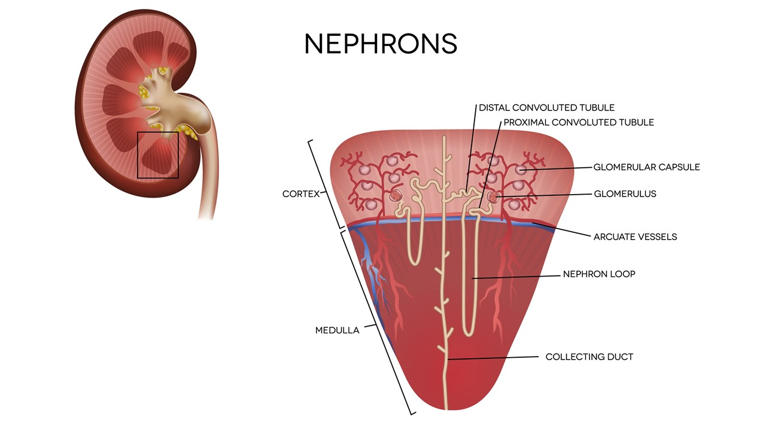

Slide 37
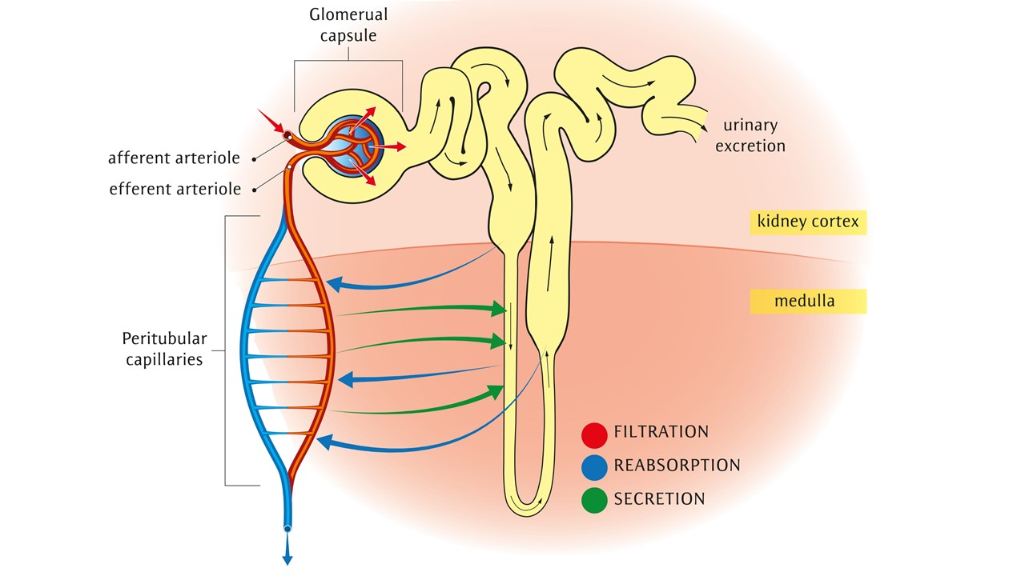

Slide 38
ADH and aldosterone
ACE inhibitors act as diuretics by indirectly decreasing the ADH and aldosterone secretion
Despite this, ACE inhibitors are not considered diuretics (they are in a class of their own and have diuretic actions)
Some of the other diuretics act on
  ADH the water saver and
  aldosterone the salt saver

Slide 39
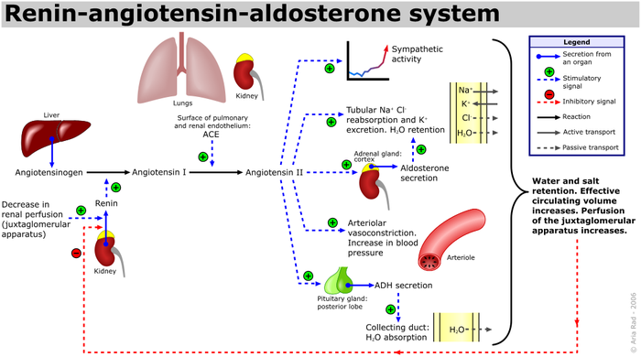
A. Rad (me), CC BY-SA 3.0 <http://creativecommons.org/licenses/by-sa/3.0/>, via Wikimedia Commons

Slide 40
.
References
McCance K, Huether S: Pathophysiology: The biological basis for disease in adults and children 8th ed. Mosby St Louis 2018
Marieb EN et al. Human Anatomy and Physiology. Pearson Education 2011
Thibodeau G: Anatomy and physiology 5th ed Mosby St. Louis 2003
Wong DL: Whaley and Wong’s nursing care of infants and children 7th ed. Mosby, St Louis, 2003
A. Rad, CC BY-SA 3.0 <http://creativecommons.org/licenses/by-sa/3.0/>, via Wikimedia Commons
Royalty free images from Shutterstock
The PowerPoint and associated Video were edited and produced by Dr. Ken Wojcikowski

